Slide 1

Final Project
Bryant McArthur

Slide 2
Overview
Compare Bilingual NMT to Multilingual NMT with Polish, English, Spanish Czech
We wanted to evaluate how the multilingual NMT performed on untrained language pairs when compared to bilingual NMT systems built from the same corpora
While doing the project I began to question whether my multilingual system would even score higher on the trained language pairs than the corresponding bilingual system.
Will the MNMT system perform better on Slavic language pairs rather than Slavic-Spanish?

Slide 3
Relevant Work
Google 2017 - Zero-Shot Translation.pdf Download
A surprising benefit of modeling several language pairs in a single model is that the model can learn to translate between language pairs it has never seen in this combination during training.
Found that small additional amounts are sufficient to reach satisfactory results.
“In our largest experiment we merge 12 language pairs into a single model and achieve only slightly lower translation quality as for the single language pair baselines despite the drastically reduced amount of modeling capacity per language in the multilingual model”

Slide 4
Relevant Work
Google 2020 - Complete MNMT.pdf Download
English Centric, Same aligned data for all language pairs
“Experimental results on a public WMT 30 language pairs dataset and an in-house 12,432 language pairs dataset demonstrated an average BLEU increase of more than 10 BLEU points for non-English language pairs”

Slide 5
Relevant Work
Language Relatedness and Lexical Closeness can help Improve Multilingual NMT:
“We observe that the BLEU score increases by 14 percent on average when the languages are grouped based on their families (IA-En & DR-En) and by 7 percent when all languages are combined in a single multilingual model (All-En) as compared to the bilingual models.”
- Not a complete Model
- Tested on Ind-Aryan vs Dravidian languages

Slide 6
Process
Olifant
Delete Duplicates
Rainbow
Cleaning pipeline and export to .txt files
Finish Cleaning (Python)
Clean More with Regex and get rid of funky characters
Tokenize (SentencePiece)
Align (Python)
Complete by aligning according to English sentences
Pretokenize with SentencePiece and save models
Tag and Split (Python)
Add <2tgt> to source and split into test, val, and training sets
OpenNMT
Translate with OpenNMT
De-Tokenize
Detokenize with pre-saved model to get clean output
BleuScores and Human Evaluations
Evaluate

Slide 7
Data
English, Spanish, Polish, Czech
Used only Church Data provided by Dr. Richardson
Legacy, Scripture, General Conference, Family History
After Cleaning and Aligning for Complete Model I ended up with 300k multi-aligned lines of data to train on.

Slide 8
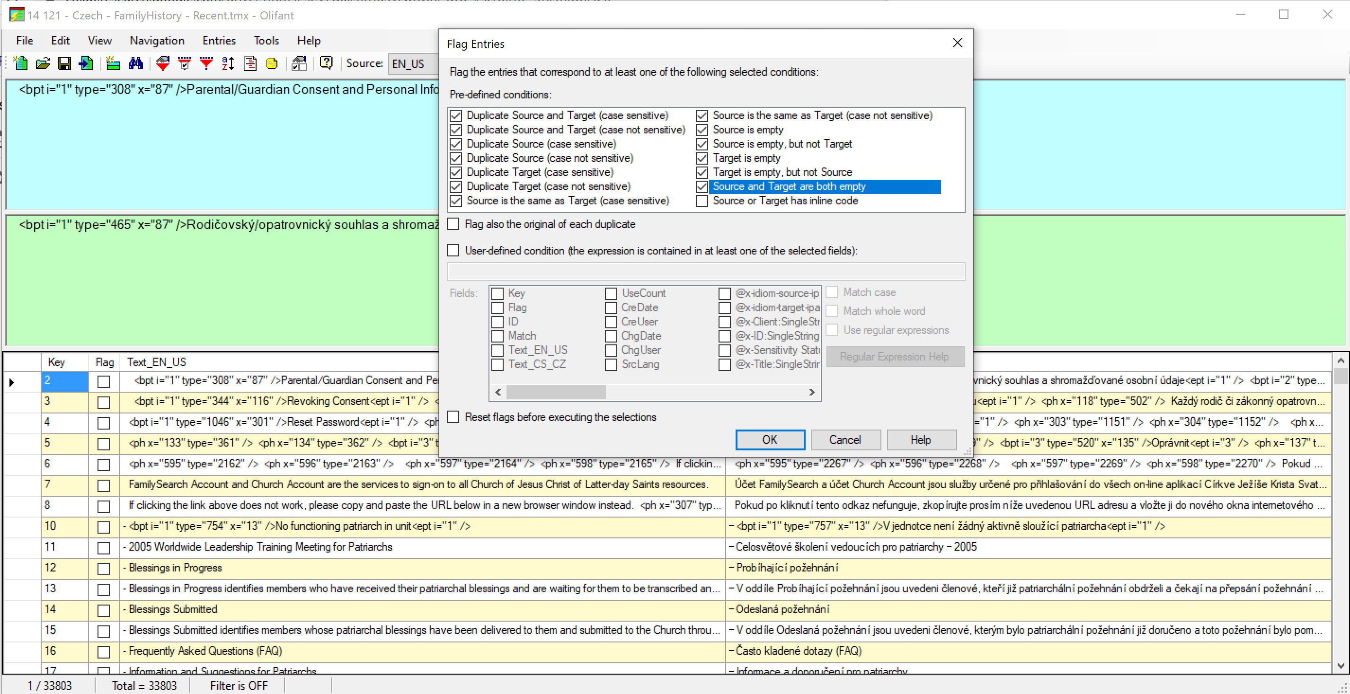
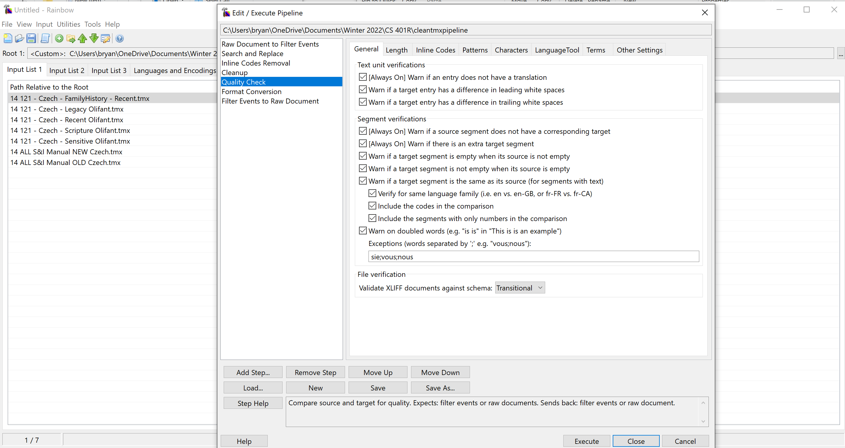
Cleaning Data
Olifant:
Flag all duplicates and empty lines then delete
Rainbow
Run through pipeline to
Remove Inline Codes
Normalize punctuation and expressions
General search and replace
Convert to parallel corpus text files
Python:
Got rid of all non-word characters at the beginning and end of the line as well as any extra spaces

Slide 9
Process
Olifant
Delete Duplicates
Rainbow
Cleaning pipeline and export to .txt files
Finish Cleaning (Python)
Clean More with Regex and get rid of funky characters
Tokenize (SentencePiece)
Align
Complete by aligning according to English sentences
Pretokenize with SentencePiece and save models
Tag and Split
Add <2tgt> to source and split into test, val, and training sets
OpenNMT
Translate with OpenNMT
De-Tokenize
Detokenize with pre-saved model to get clean output
BleuScores and Human Evaluations
Evaluate

Slide 10
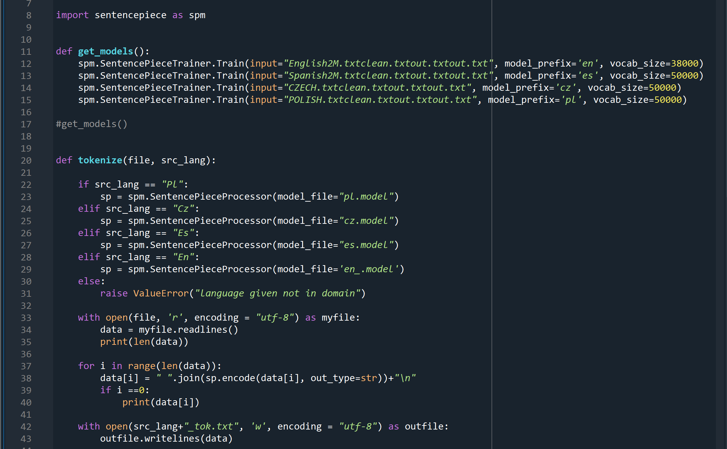
Tokenize
Example:
Sentence = “<2pl> This is testing the tokenizer“
print(“ “.join(sp.encode(sentence, out_type=str)))
>>>
▁ < 2 p l > ▁ T his ▁is ▁testing ▁the ▁token ize r

Slide 11
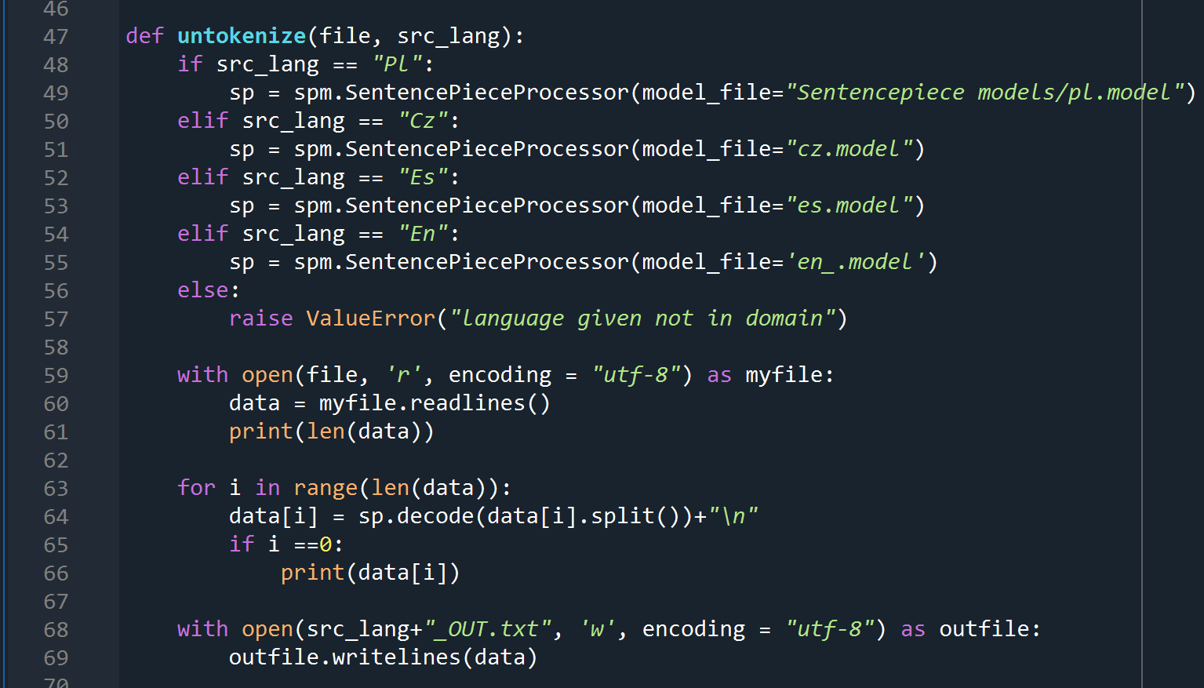
De-Tokenize
Example:
sentence = "▁paweł ▁wyjaśnił , ▁jak ▁abraham ▁został ▁usprawiedliwion y ▁poprzez ▁łaskę“
sp.decode(sentence.split())
>>>
paweł wyjaśnił, jak abraham został usprawiedliwiony poprzez łaskę

Slide 12
Process
Olifant
Delete Duplicates
Rainbow
Cleaning pipeline and export to .txt files
Finish Cleaning (Python)
Clean More with Regex and get rid of funky characters
Tokenize (SentencePiece)
Align
Complete by aligning according to English sentences
Pretokenize with SentencePiece and save models
Tag and Split
Add <2tgt> to source and split into test, val, and training sets
OpenNMT
Translate with OpenNMT
De-Tokenize
Detokenize with pre-saved model to get clean output
BleuScores and Human Evaluations
Evaluate

Slide 13
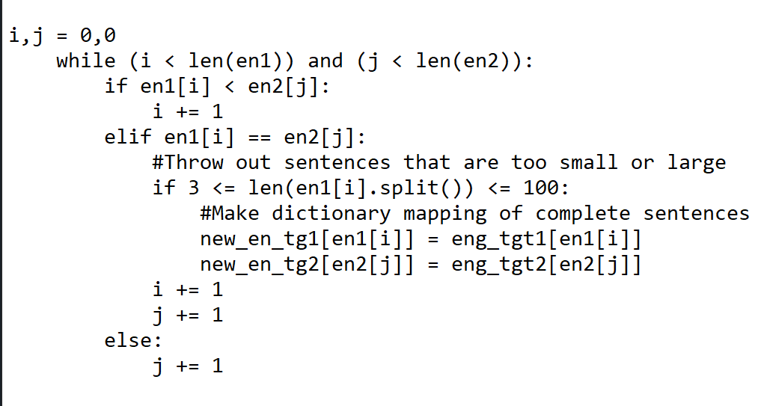
Align for Complete Model
After dictionary of parallel text are both sorted according to the English sentences.
If the English sentence in the first dictionary is “less than” the English sentence in the second dictionary skip it and move on.
If they are equal you found a match and move on.
Etc.

Slide 14
Process
Olifant
Delete Duplicates
Rainbow
Cleaning pipeline and export to .txt files
Finish Cleaning (Python)
Clean More with Regex and get rid of funky characters
Tokenize (SentencePiece)
Align
Complete by aligning according to English sentences
Pretokenize with SentencePiece and save models
Tag and Split
Add <2tgt> to source and split into test, val, and training sets
OpenNMT
Translate with OpenNMT
De-Tokenize
Detokenize with pre-saved model to get clean output
BleuScores and Human Evaluations
Evaluate

Slide 15
Tag and Split
def tag(file, lang):
Add the tag <2tgt> to the beginning of every sentence of the source text files.
For example for my English to Polish model I would have the sentence: “<2pl> Joseph Smith was a prophet of God.”
"""Create Complete Model tokenized txt files"""
#En-Pl
tag("En_tok.txt", "Pl")
rmvtag("Pl_tok.txt")
stst1, sval1, strn1 = split("En_tok.txt", True)
ttst1, tval1, ttrn1 = split("Pl_tok.txt", False)
…Repeat for other language pairs (6 total)
with open("Tsrc-test.txt", 'w', encoding = "utf-8") as outfile:
outfile.writelines(stst1+stst2+stst3+stst4+stst5+stst6)
…Repeat for src and target test, train and validation text files
def rmvtag(file):
Remove any tags at the beginning of the sentence.
def split(file, src=True):
Split the files by 80-10-10 Rule for Training, Test, and Validation
Every 10th sentence would be added to test, every 10th sentence added to validation, and the rest added to training for equal representation from sorted files.

Slide 16
Process
Olifant
Delete Duplicates
Rainbow
Cleaning pipeline and export to .txt files
Finish Cleaning (Python)
Clean More with Regex and get rid of funky characters
Tokenize (SentencePiece)
Align
Complete by aligning according to English sentences
Pretokenize with SentencePiece and save models
Tag and Split
Add <2tgt> to source and split into test, val, and training sets
OpenNMT
Translate with OpenNMT
De-Tokenize
Detokenize with pre-saved model to get clean output
BleuScores and Human Evaluations
Evaluate

Slide 17
OpenNMT
Training Steps | En-Pl Bleu Score
16k | 21.82
20k | 22.57
24k | 25.68
28k | 27.35
32k | 27.52
36k | 27.70
40k | 29.19
44k | 28.95
48k | 28.28
52k | 32.69
56k | 33.13
60k | 33.40
64k | 33.99
68k | 34.74
72k | 35.28
76k | 35.38
80k | 35.23
84k | 35.84
88k | 35.88
Bilingual Models
I first evaluated Bleu score every 4k steps with En-Pl model until I was satisfied with a stabilized bleu score. Then I trained the other 3 models with the same number of steps.

Slide 18
OpenNMT
Used Zero – Shot translation
One large corpus for training (like Wade):
<2pl> eng
<2cz> eng
<2es> eng
<2en> pl
<2en> cz
<2en> es
Trained for 500k steps - Took 18 Hours
Using exact same .yaml file as Ammon up to 400k steps using 6 encoding and decoding layers.
Multilingual Model
What didn’t work:
Using my own GPU
Default OpenNMT tokenizer transformers
Splitting training data into separate corpora with the same language pairs
Trying different vocabulary sizes in OpenNMT and Sentencepiece tokenizer
Experimenting shared and not shared vocab

Slide 19
OpenNMT
Multilingual Model Bleu Score Results!!
Steps | En-Pl | Pl-Es | Es-Cz | Pl-Cz
400k | 2.60 | 2.11 | 2.13 | 2.68
500k | 2.60 | 2.11 | 2.13 | 2.68

Slide 20
Output
BiLingual Models
Multilingual Model
English Sentence:
▁a ▁bible ▁verse ▁came ▁to ▁mind
En-Pl:
▁przychodzi ▁do ▁głowy ▁werset ▁z ▁biblii
Pl-Es:
▁me ▁vino ▁a ▁la ▁mente ▁un ▁pasaje ▁de ▁la ▁biblia
Pl-Cz:
▁přišel ▁jsem ▁na ▁jednu ▁pasáž ▁z ▁bible
Es-Cz:
▁jeden ▁verš ▁z ▁bible ▁mě ▁napadl
English Sentence:
<2tgt> ▁a ▁bible ▁verse ▁came ▁to ▁mind
En-Pl:
a la biblia▁vino a la▁mente
Pl-Es:
i came to my head de la biblia
Pl-Cz:
i come to my▁mind▁from the bible
Es-Cz:
a▁verse of the bible came to my▁mind

Slide 21
Evaluation - Bleu scores
Bilingual Models
Multilingual Model
Steps | En-Pl | Pl-Es | Es-Cz | Pl-Cz
16k | 21.82 | 25.67 | 19.91 | 20.44
24k | 25.68 | 27.47 | 22.55 | 23.73
32k | 27.52 | 29.68 | 24.76 | 26.50
40k | 29.19 | 31.54 | 26.48 | 25.79
48k | 28.28 | 32.08 | 27.59 | 25.89
56k | 33.13 | 34.61 | 30.26 | 29.97
64k | 33.99 | 36.02 | 31.89 | 31.22
72k | 35.28 | 36.75 | 32.86 | 31.64
80k | 35.23 | 37.05 | 32.79 | 31.95
88k | 35.88 | 37.37 | 33.63 | 32.05
Steps | En-Pl | Pl-Es | Es-Cz | Pl-Cz
400k | 2.60 | 2.11 | 2.13 | 2.68
500k | 2.60 | 2.11 | 2.13 | 2.68

Slide 22
Conclusions or lack thereof
Uncertainties with multilingual model:
Certainties with Bilingual models:
“English-Centric” Model
Zero-Shot Translation did not bridge any gaps for untrained pairs
Zero-Shot Translation confused the pairs that it was trained on
Complete model did not improve anything. Multiple sentences mapped to the same English sentence may be why the ouput was dominantly English. Half of the target training data was English.
Inconclusive whether language families would improve a working MNMT system.
Pl-Es consistently scored highest on bilingual models with equal training steps. So Language Families has no/little correlation.
Models do NOT stabilize around 15k training steps like OpenNMT forum suggests
Models with similar sized training data converge around the same step size
Language pairs previously translated through pivot language (English) does not degrade performance when compared to previous direct translation for training.

Slide 23
Conclusion – Take Aways
Zero – Shot translation does not always work (especially while only building model to and from one language)
More training steps is not always the solution.
Familiarize yourself with the framework before you start training.

Slide 24
Possible Follow-Up Work
Get cMNMT system working:
- Try different methods
- Use different framework
If I get it to work:
- Receive Human Evaluations
- Increase the language pairs:
- Related paper used 12 different languages for Indo-Aryan and Dravidian
- Build MNMT system with just Slavic languages and then compare to MNMT system with all languages.

Slide 25

The End
Questions?

